Slide 1
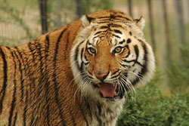
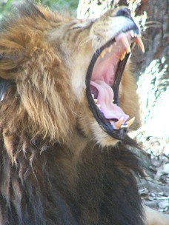
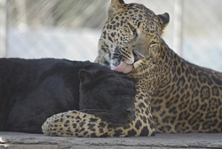
Big Cat Refuges
Nicole L. Fuller
Penn State
October 19, 2011

Slide 2
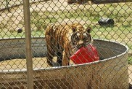
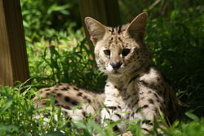
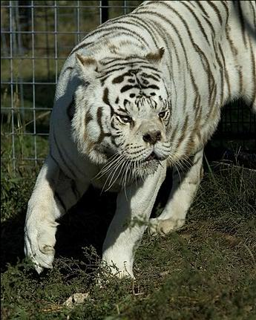
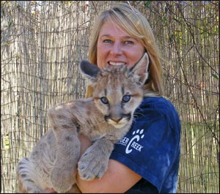
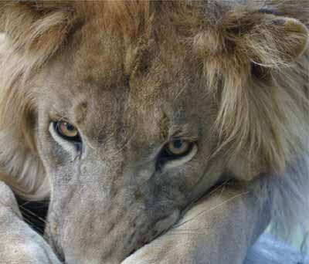
Overview
Types of Animals
Why Cats are at Refuge
Life at the Refuge
Google.com/images

Slide 3
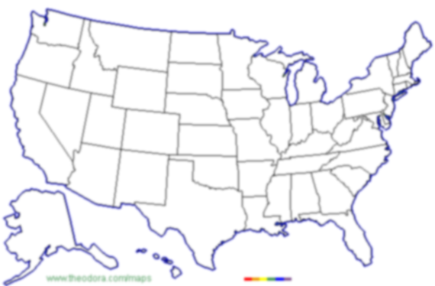
The Wildcat Sanctuary
http://www.wildcatsanctuary.org/
Wisconsin Big Cat Rescue
http://www.wisconsinbigcats.org/index.html
Valley of the Kings
http://votk.org/
The Wild Animal Sanctuary
http://www.wildanimalsanctuary.org/home.html
Great Cats of Indiana
http://www.greatcatsofindiana.org/
Serenity Springs Wildlife Preserve
http://www.serenityspringswildlife.org/index.htm
Exotic Feline Rescue Center
http://www.exoticfelinerescuecenter.org/home.html
Shambala
http://www.shambala.org/
Carolina Tiger Rescue
http://www.carolinatigerrescue.org/default.asp
Pride rock Wildlife Refuge
http://www.priderock.org/
Turpentine Creek Wildlife Refuge
http://www.turpentinecreek.org/index.html
Tiger Haven
http://www.tigerhaven.org/index.asp
Yogie and Friends Exotic Cat Sanctuary
http://www.yogieandfriends.org/new/
Care
http://bigcatcare.org/
E.A.R.S.
http://www.earsinc.net/
Big Cat Habitat and Gulf Coast Sanctuary
http://bigcathabitat.org/
Tiger Creek Wildlife Refuge
http://www.tigercreek.org/
Google.com/images
International Exotic Animal Sanctuary
http://www.bigcat.org/

Slide 4
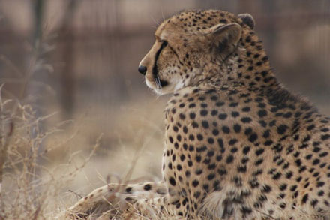
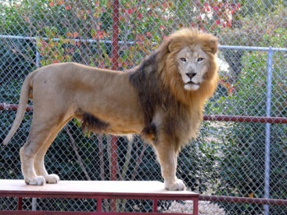
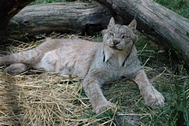
Recap
Types of Animals
Why Cats are at Refuge
Life at the Refuge

Slide 5
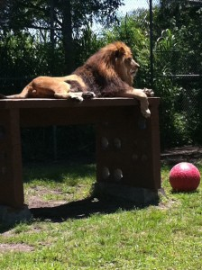
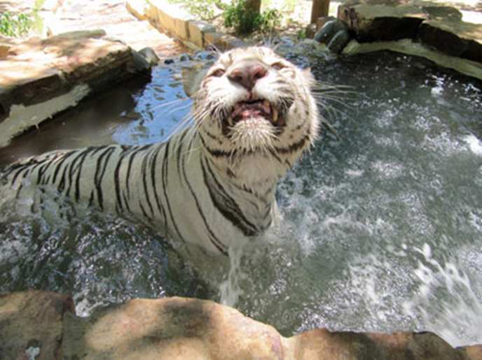
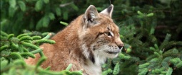
A place for a variety of exotic animals, who have nowhere else to go, to call home

Slide 6
Sources
Big Cat Habitat and Gulf Coast Sanctuary in Sarasota, Florida | A Safe Place for Animals. Big Cat Habitat. Web. <http://bigcathabitat.org/>.
Big Cat Wildlife Refuge|Siberian Tiger|Bengal Tiger|African Lion|Big Cat Sanctuary|Turpentine Creek. Web. <http://www.turpentinecreek.org/index.html>.
CARE. CARE. Web. <http://bigcatcare.org/>.
Carolina Tiger Rescue - Home Page. Carolina Tiger Rescue, 2009. Web. <http://www.carolinatigerrescue.org/default.asp>.
Endangered Animal Rescue Sanctuary-EARS - HOME. EARS Inc, 2009. Web. <http://www.earsinc.net/>.
Exotic Feline Rescue Center. Web. <http://www.exoticfelinerescuecenter.org/home.html>.
Great Cats of Indiana Sanctuary & Rescue Facility for Big Cats. Great Cats of Indiana, Inc., 2007. Web. <http://www.greatcatsofindiana.org/>.
Help Us Rescue and save Tigers, Lions, Cougars, and Other Big Cats from Abuse. PrideRock, 2005. Web. <http://www.priderock.org/>.
Home | WildAnimalSanctuary.com : America's Premier Sanctuary For Large Carnivores. Goozmo Systems, 2012. Web. <http://www.wildanimalsanctuary.org/home.html>.
Serenity Springs Wildlife Center. Serenity Springs Wildlife Center, 2008. Web. <http://www.serenityspringswildlife.org/index.htm>.
The Shambala Preserve Presented by The Roar Foundation. The Roar Foundation, 2011. Web. <http://www.shambala.org/>.
Tiger Creek Wildlife Refuge (TCWR), Tigercreek.org, Tyler, Texas, Big Cat Rescue, save the Tigers, Lions, Tigers, Sanctuary, Wildlife Refuge, Zoos, Great Cats. Tiger Missing Link Foundation, 2003. Web. <http://www.tigercreek.org/>.
Tiger Haven. AIMS Computer Systems, 2006. Web. <http://www.tigerhaven.org/index.asp>.
Valley of the Kings Home Page. Web. <http://votk.org/>.
The Wildcat Sanctuary. The Wildcat Sanctuary, 2011. Web. <http://www.wildcatsanctuary.org/>.
Wisconsin Big Cat Rescue & Educational Center. TechAnalysts, Inc. Web. <http://www.wisconsinbigcats.org/index.html>.
Yogie and Friends Exotic Cat Sanctuary. Web. <http://www.yogieandfriends.org/new/>.

