Slide 1
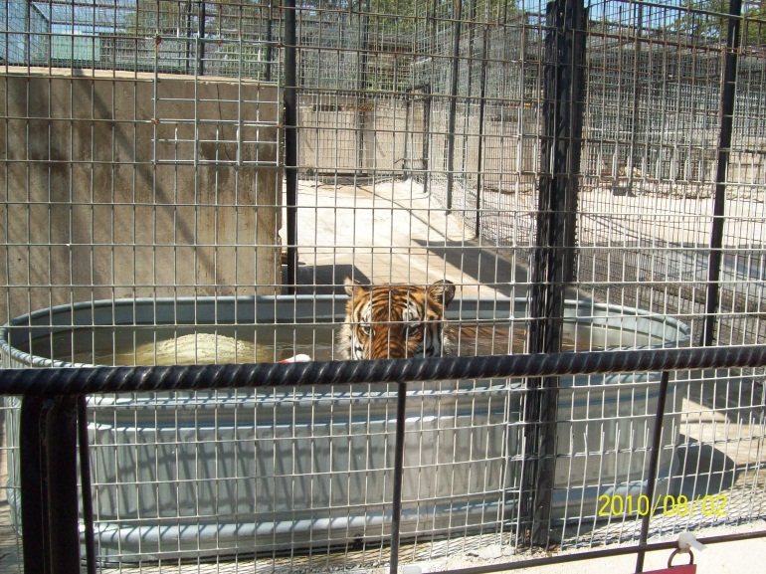
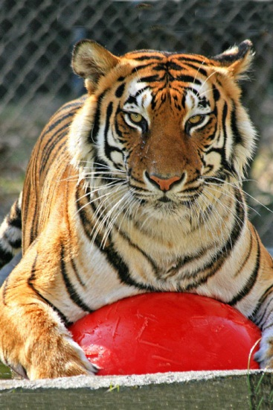
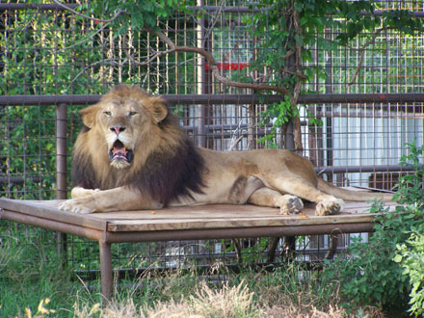
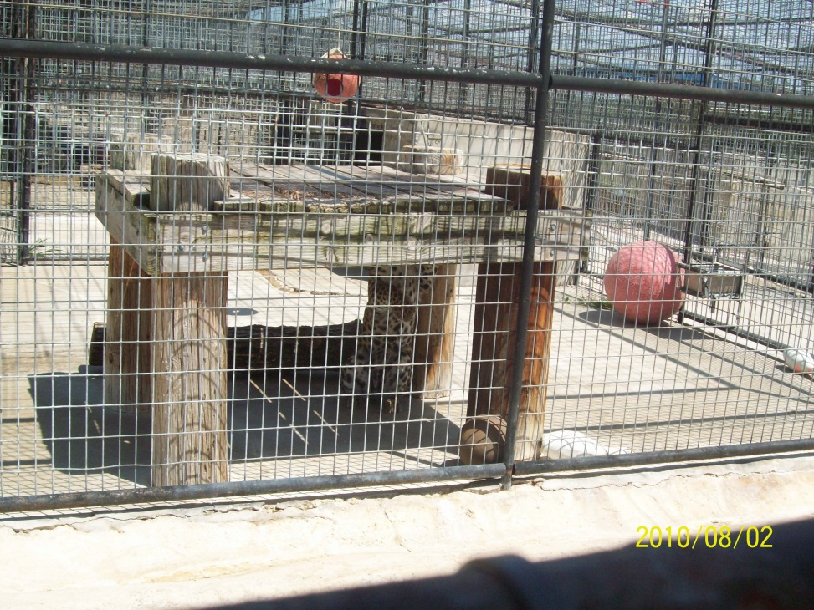
My Pic
Life at Refuge
My Pic

Slide 2
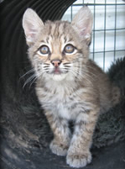
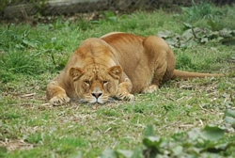
Are not euthanized
No selling, buying, or trading
No breeding
Many are spayed or neutered
Only animals born on site, if pregnant when brought
A place to live for the rest of life, permanent home

Slide 3
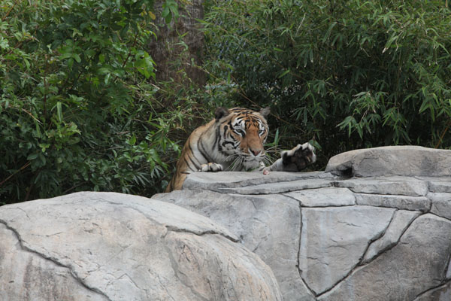
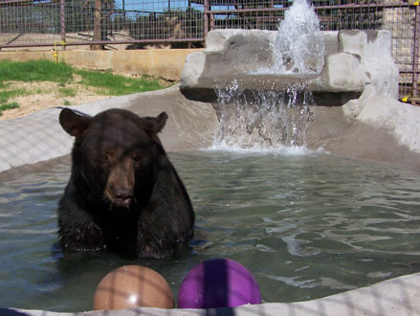
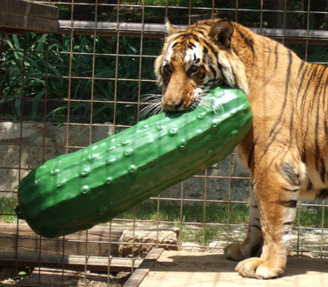
Some have smaller areas to live than others
As refuges receive money to build, larger habitats are made for animals
Habitats are made like natural environment
Living Spaces are kept clean
They have shade, water, some have fans
Are given enrichment (balls, pumpkins, etc.)

Slide 4
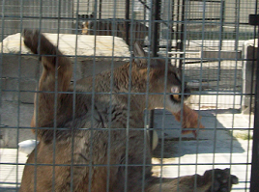
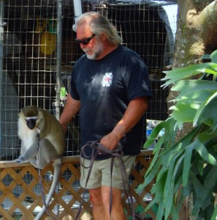
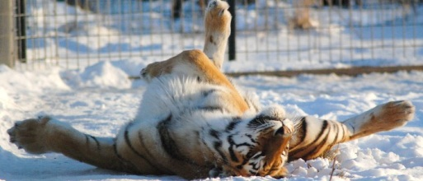
My Pic
Have Veterinary care
Fed best diet available
Fed on schedules
Provide stable social groups
Interaction with workers
Some are facilities open to public, others are not
Animals watched and checked to make sure okay
Workers know their animals and can tell them apart
A place to call home

