Slide 1
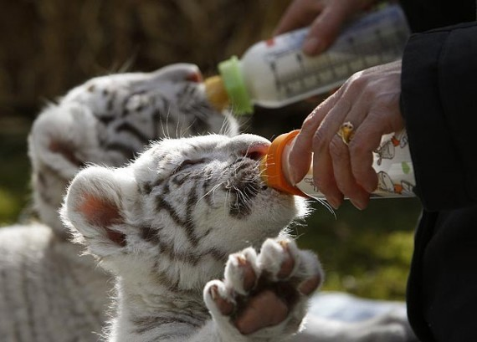
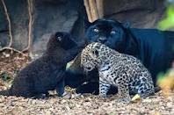
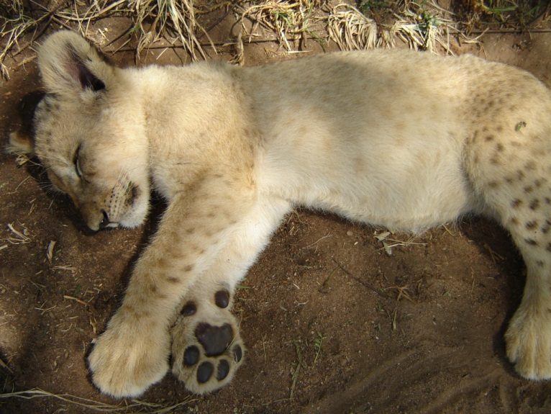
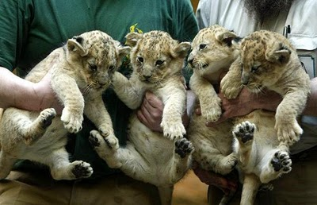
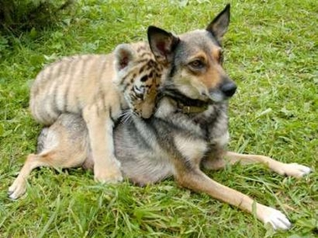
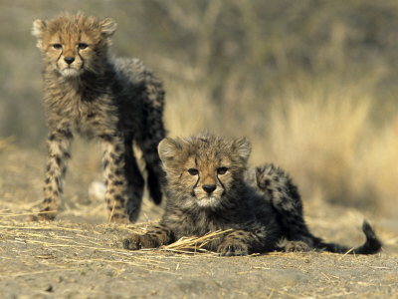
http://www.telegraph.co.uk/news/picturegalleries/picturesoftheday/8136550/Pictures-of-the-day-16-November-2010.html?image=8
http://www.theblogismine.com/2010/04/22/beuatiful-white-tiger-cubs-at-play/
http://feministphilosophers.wordpress.com/2010/07/04/sunday-big-cat/dsc03675/
http://animalszooguru.blogspot.com/2010/11/cheetahs-cubs-tigers-cubbs-pics-cub.html
http://www.animalliberationfront.com/News/AnimalPhotos/Animals_1-10/DogTigerMum.htm

Slide 2
http://www.ilovewavs.com/Effects/Animals/Animals.htm
http://en.loadtr.com/tigers-490502.htm

Slide 3
Big Cats Do Not Make Good Pets
Nicole Fuller
Speech Class
November 8, 2011

Slide 4
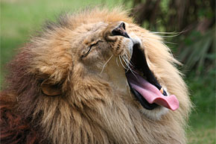
Overview
Not always Cubs
Dangerous
Inhumane to Cats
Unwanted
http://www.travelmuse.com/articles/tampa-bay/tampa-tours

Slide 5
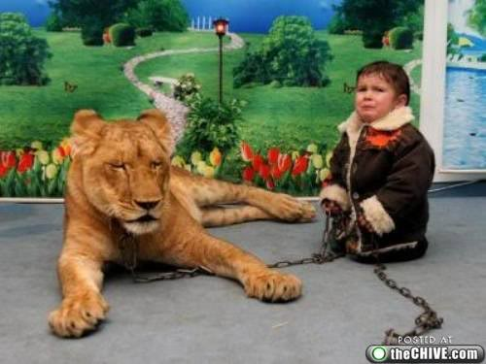
Not always Cubs
National Geographic: Exotic pets more than owners bargained for
Turpentine Creek Wildlife Refuge: Cats become aggressive and stronger in their adolescent years.
National Geographic: Cats
can eat more than 15 lbs.
a day and grow more than
500 lbs
http://animalsversesanimals.yuku.com/topic/2246

Slide 6
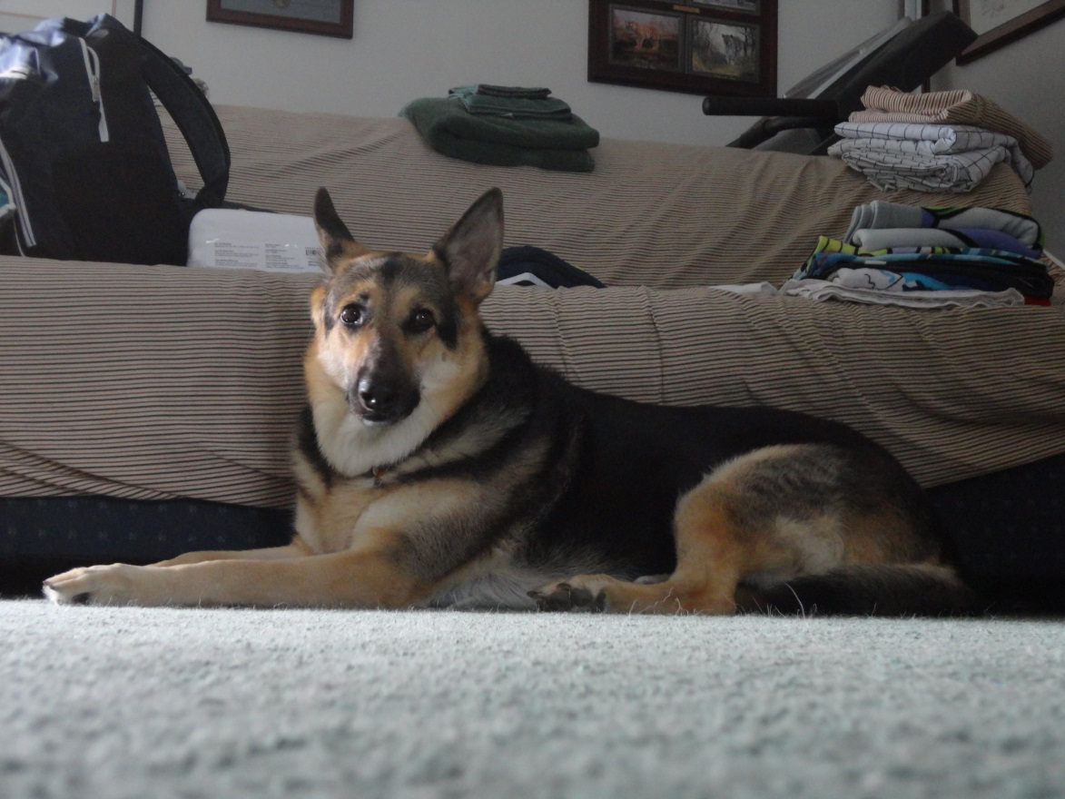
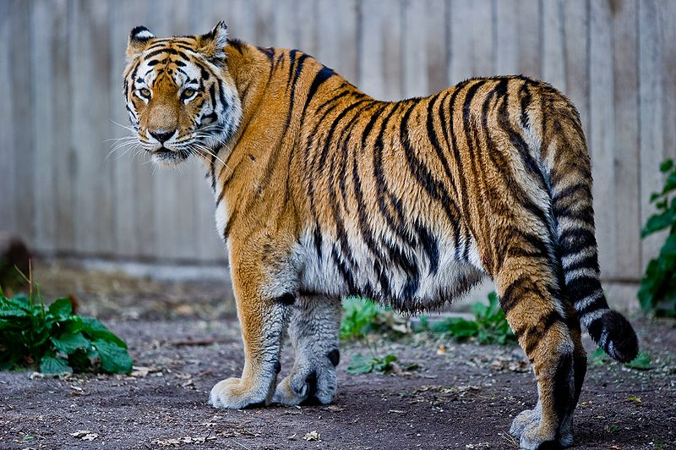
My Picture
5X
100 Pounds
http://en.wikipedia.org/wiki/File:Captive_Siberian_tiger_-_Copenhagen_Zoo,_Denmark.jpg

Slide 7
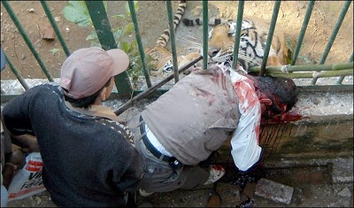
Dangerous
United States Department of Agriculture: Though they are loving and friendly at times they are still dangerous
ASPCA: Unpredictable, changing nature with seasons and life cycles
ASPCA: Can carry
diseases
http://malct32.blogspot.com/2010/07/panthera-tigris.html

Slide 8
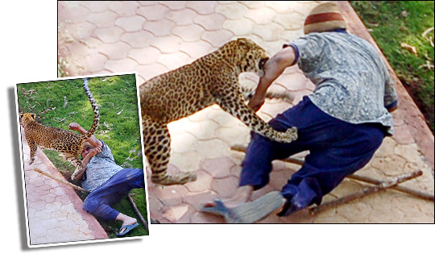
Captive Wildlife Animal Protection Coalition:
A 3yr old and 9yr old killed by pet tigers in Texas
A toddler had arm bitten off by a pet tiger
A 4 yr old had surgery after being bitten by pet serval
http://www.thesun.co.uk/sol/homepage/news/28923/Big-cats-leopardy-jeopardy.html

Slide 9
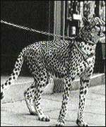
Inhumane for Animals
United States Department of Agriculture: People do not have necessary knowledge, equipment, nutrition, medical care, etc. which can lead to premature death for pets
Captive Wildlife Animal Protection Coalition: Most animals live alone in small, cramped cages
ASPCA: Exercise, miles daily, but owners can not give that
ASPCA: Big cats can become
aggressive, so some people beat
them into submission
http://mybigcatblog.blogspot.com/2011_03_01_archive.html

Slide 10
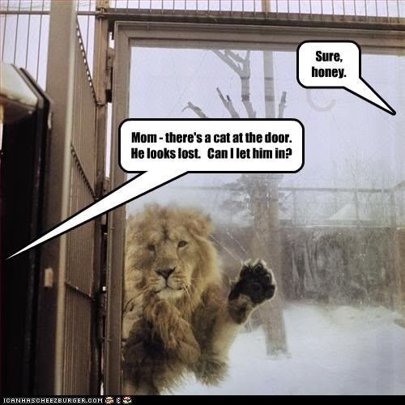
Unwanted
United States Department of Agriculture: Animals become expensive and dangerous, so owners do not want them anymore
Captive Wildlife Animal Protection Coalition: Can not be released into the wild
ASPCA: Most zoos do not
take them, dealers do not
take them back, few refuges
are out there to take them
Captive Wildlife Animal Protection
Coalition: Some people kill them
for organs, skins, or meat
http://animalsversesanimals.yuku.com/topic/2246

Slide 11
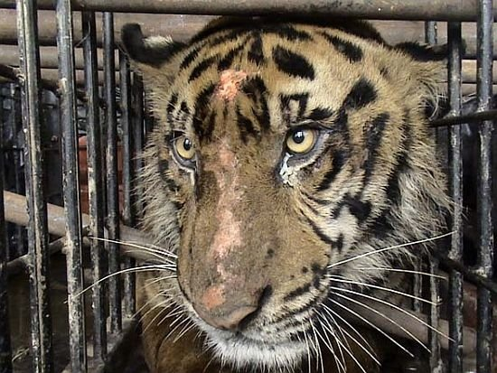
Recap
Cubs get bigger
Dangerous
Inhumane to
animals
They become
unwanted
http://www.squidoo.com/wildanimalsaspets?utm_source=google&utm_medium=imgres&utm_campaign=framebuster

Slide 12
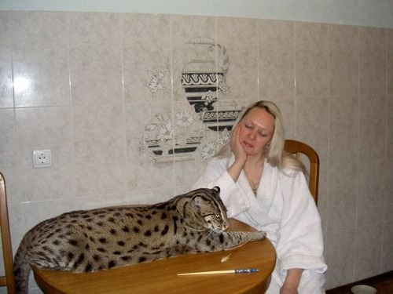
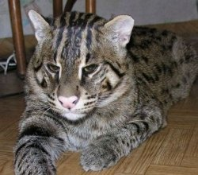
Conclusion
Captive Wildlife Animal Protection Coalition: Between 10-20 thousand Big Cats owned privately
Spread the Word Big Cats Do NOT Make Good Pets
http://www.squidoo.com/wildanimalsaspets?utm_source=google&utm_medium=imgres&utm_campaign=framebuster

Slide 13
Sources
"About TCWRF - Big Cats Do Not Make Pets." Big Cat Wildlife Refuge|Siberian Tiger|Bengal Tiger|African Lion|Big Cat Sanctuary|Turpentine Creek. Web. Nov. 2011. <http://www.turpentinecreek.org/big-cats.html>.
"Exotic Animals as Pets." ASPCA. ASPCA, 2011. Web. <http://www.aspca.org/adoption/adoption-tips/exotic-animals.aspx>.
Handwerk, Brian. "Big Cats Kept as Pets Across U.S., Despite Risk." Daily Nature and Science News and Headlines | National Geographic News. National Geographic Society, 9 Oct. 2003. Web. Nov. 2011. <http://news.nationalgeographic.com/news/2002/08/0816_020816_EXPLcats.html>.
"Large Wild And Exotic Cats Make Dangerous Pets." (2000): 2-3. United States Department of Agriculture. Web. <http://www.aphis.usda.gov/animal_welfare/downloads/big_cat/position.pdf>.
"Wild Animals Are Not Pet." Captive Wildlife Animal Protection Coalition. Web. <http://cwapc.org/education/download/BigCatFacts.pdf>.

