Slide 1
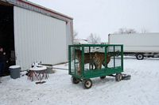
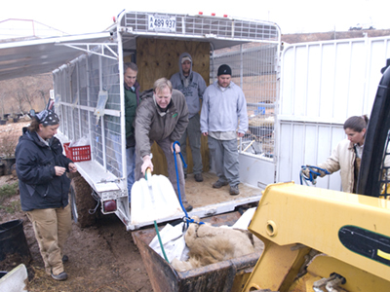
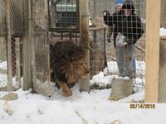
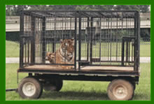
Why?

Slide 2
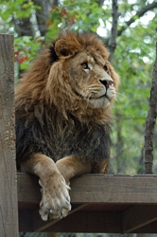
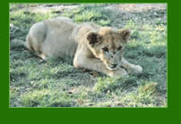
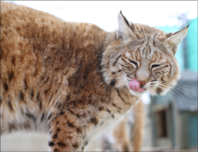
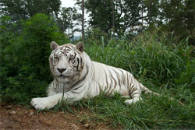
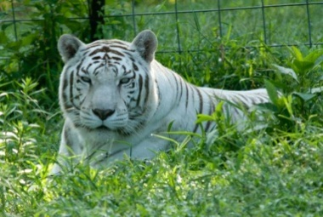
Unwanted – At Exotic Feline Rescue Center, King was brought after neighbor found out owner could not afford food and was going to have lion shot
Unable to care for –Dandy Lion who was brought to Tiger Haven, malnourished and dehydrated, by a couple who realized they did not have facility to care for tiger
Abandoned – At Wild Animal Sanctuary, Sally was brought after being abandoned at a truck stop. She traveled around with her owner until she became aggressive and destructive and threw her out
Abused -- At Turpentine Creek Wildlife Refuge are two white tigers, Conway and Loretta, they bred many cubs, but when cubs were deformed and dying , so they were of no use to the breeders

Slide 3
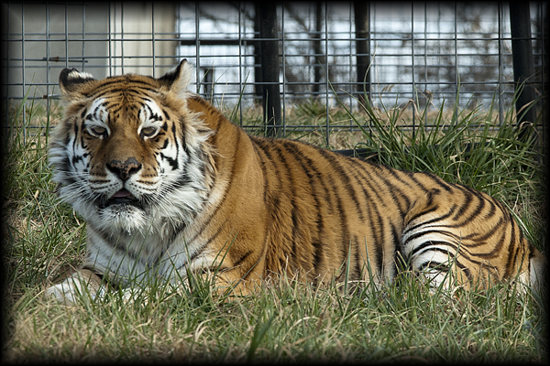
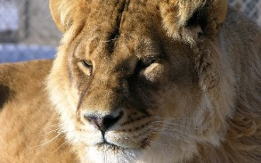
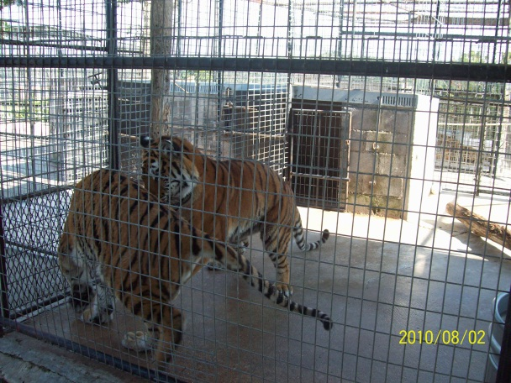
Confiscated – At Turpentine Creek Wildlife Refuge, Sierra was brought after being confiscated by Texas SPCA after being fed dog food and being declawed
Retired – At Serenity Springs Wildlife Preserve Savannah, a lioness, is a retired movie star (“Second Hand Lions”)
Born on Site -- Few
BB King & Mack – born to Tigger G at Turpentine Creek Wildlife Refuge because she was pregnant when brought to refuge
Neglect
No where Else to Go
My Pic

Slide 4
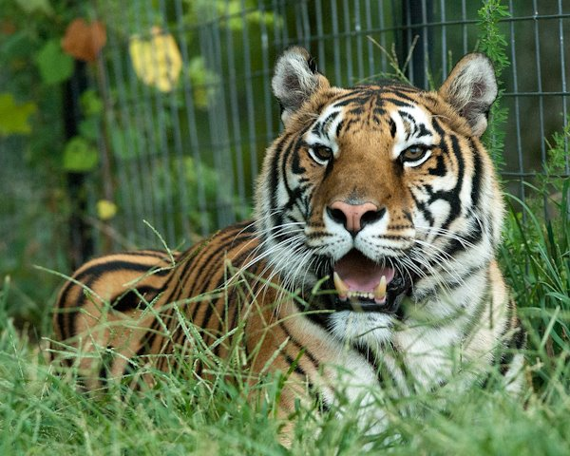
India – Story I heard on tour
A man owned her for a year and a half
She became too aggressive for him to handle
Drove her 60 miles to a national forest and left her there
Four days later found India on his front porch
Next day took her to Turpentine Creek Wildlife Preserve

Slide 5
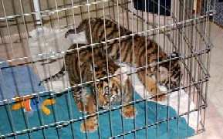
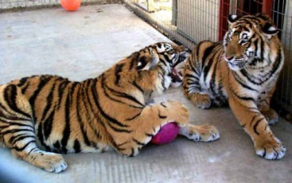
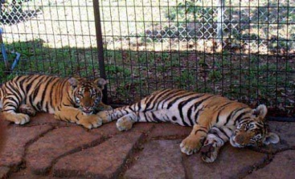
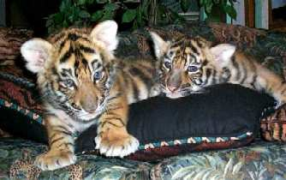
Jammu and Kashmir
Throw aways by breeders because they are not white tigers
Needed immediate veterinary care, which owner/ breeder thought more than they are worth
They were removed from life threatening care and given veterinary care and brought to Pride rock at 7 weeks old

Slide 6
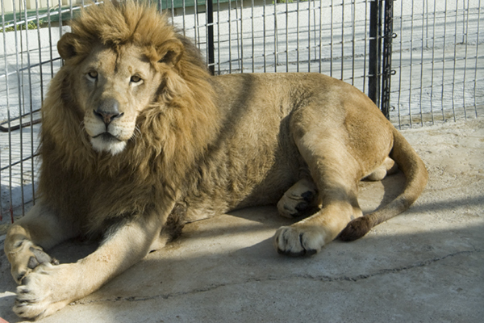
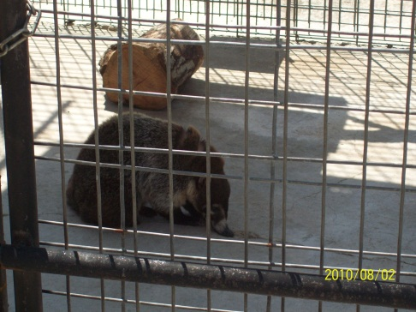
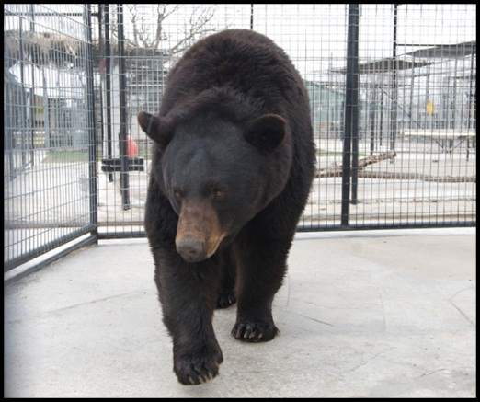
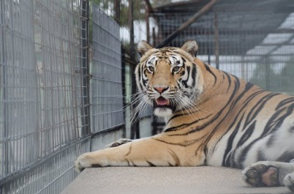
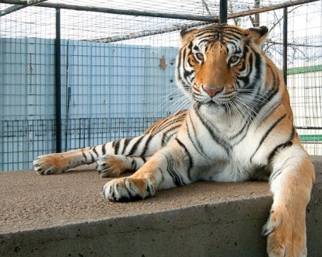
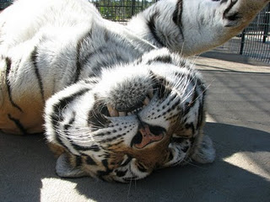
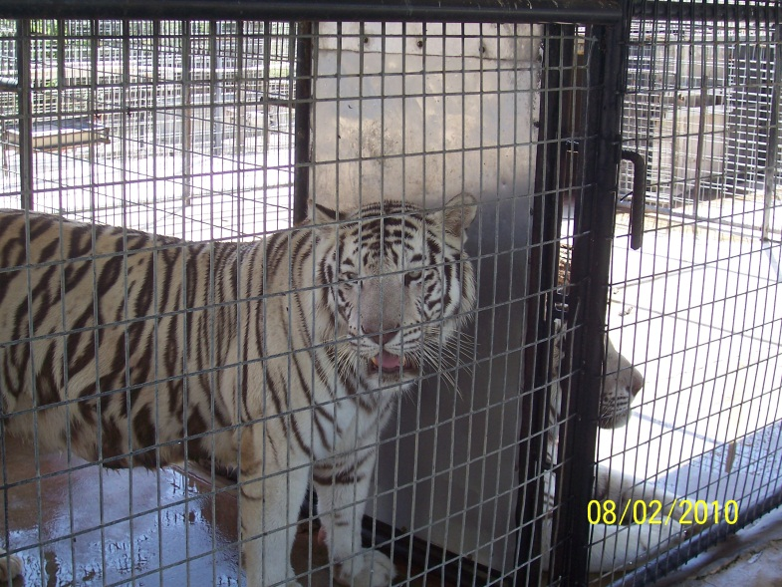
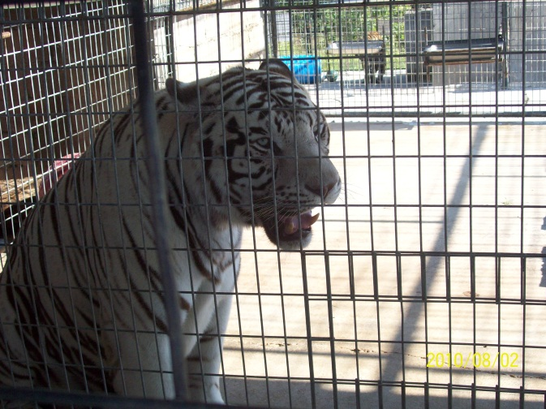
From Zoo
Tsavo
Flip
Abigail
Harley
My pic
Formally open to public Predator World had to get rid of these animals to reopen
Had to anethesize cats and bear and carry them one by one to rescue trailer
Zena
Athena
Chuff
Zeus
Magic
My pic
My pic
My pic

